Slide 1
Use of a llm and constraint programming paradigm for solving combinatorial problems
Zaim Mehić, Faculty of Information Technologies
“Džemal Bijedić“ University of Mostar

Slide 2
CONTENTS
Introduction
Methods
Results
Discussion

Slide 3
introduction
Scheduling problems belong to Combinatorial problems.
Large Language Model
Solving one with the help of the other!
If proven successfull benefits could be seen in fields such as: education, sports, manufacturing, agriculture and more.

Slide 4
MEtHODS
Google OR-Tools – Solve our constraint programming problem;
Roslyn – Compiling C# code at runtime;
OpenAI‘s chat client – Generate constraints written in C# code based on users prompts.
The problem: Create a shift schedule for employees based on the following variables:
  Number of employees;
  Number of days;
  Number of shifts;

Slide 5
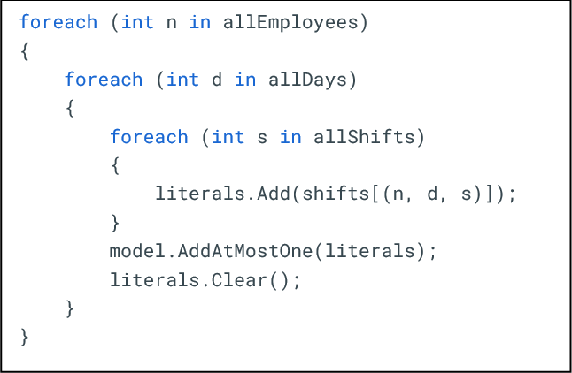
MEtHODS

Slide 6
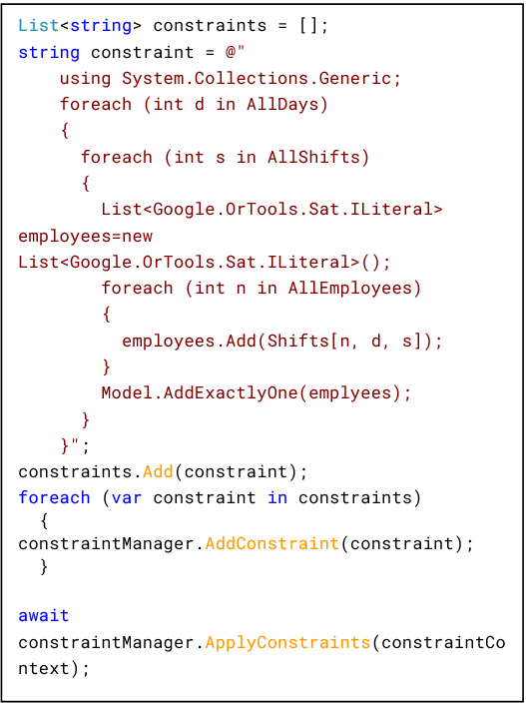
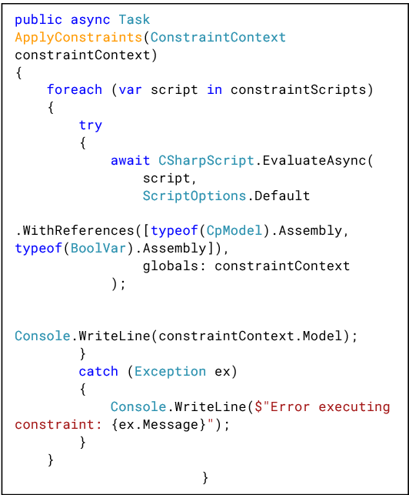

Slide 7
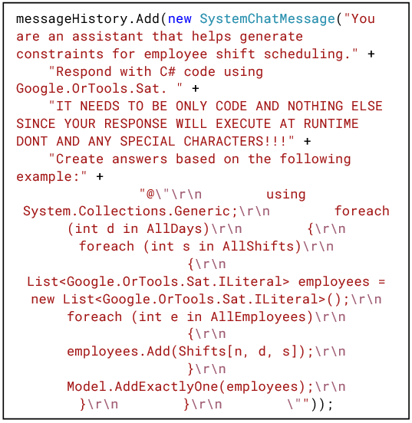

Slide 8
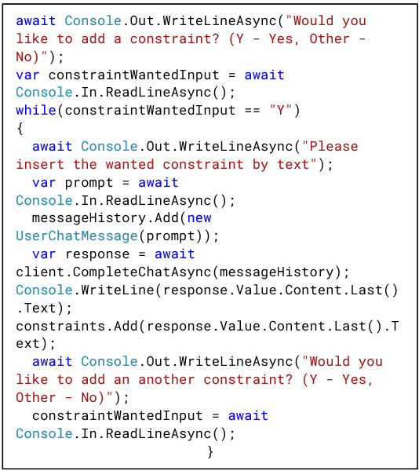

Slide 9
RESULTS
Variable values:
  Days – 5
  Shifts – 3
  Employees – 4
Constraint prompts:
  Each shift needs to be assigned to exactly one employee.
  Each employee needs to work mostly one shift per day and not more.
  Employee 0 most not be working any shifts on Day 4.
  No employee works the same shift two days in a row.
  Each employee gets at least one day off.

Slide 10
Day | Solution #1
 | Employee | Shift
0 | 0 | 2
 | 1 | 0
 | 3 | 1
1 | 0 | 0
 | 1 | 1
 | 2 | 2
2 | 1 | 0
 | 2 | 1
 | 3 | 2
3 | 0 | 2
 | 1 | 1
 | 2 | 0
4 | 1 | 0
 | 2 | 2
 | 3 | 1

Slide 11
Day | Solution #2
 | Employee | Shift
0 | 0 | 2
 | 1 | 0
 | 3 | 1
1 | 0 | 0
 | 1 | 1
 | 2 | 2
2 | 1 | 0
 | 2 | 1
 | 3 | 2
3 | 0 | 1
 | 1 | 2
 | 2 | 0
4 | 1 | 0
 | 2 | 2
 | 3 | 1

Slide 12
Day | Solution #3
 | Employee | Shift
0 | 0 | 2
 | 2 | 0
 | 3 | 1
1 | 0 | 0
 | 1 | 1
 | 2 | 2
2 | 1 | 0
 | 2 | 1
 | 3 | 2
3 | 0 | 2
 | 1 | 1
 | 2 | 0
4 | 1 | 0
 | 2 | 2
 | 3 | 1

Slide 13
DISCUSSION
Solutions take 4 constraints into consideration without taking the last one.
Initial system prompt needs to be corrected since it doesn‘t provide the application with the correct code every time.

Slide 14
THANK YOU
Zaim Mehic​
zaim.mehic@edu.fit.ba

